Slide 1
Software Estimation Technique
Subhash Paudel
MSCSKE, IOE, Pulchowk Campus
subhash@achsnepal.edu.np
Notes:
M.Sc. Computer Engineering, Computer System and Knowledge Engineering

Slide 2
Outline
Software Effort Estimation: Problems with over and under estimations
Basis of software Estimating
Software effort estimation techniques
Expert Judgment
Estimating by analogy
Bottoms-up estimating
Top-down approach
Parametric models.

Slide 3
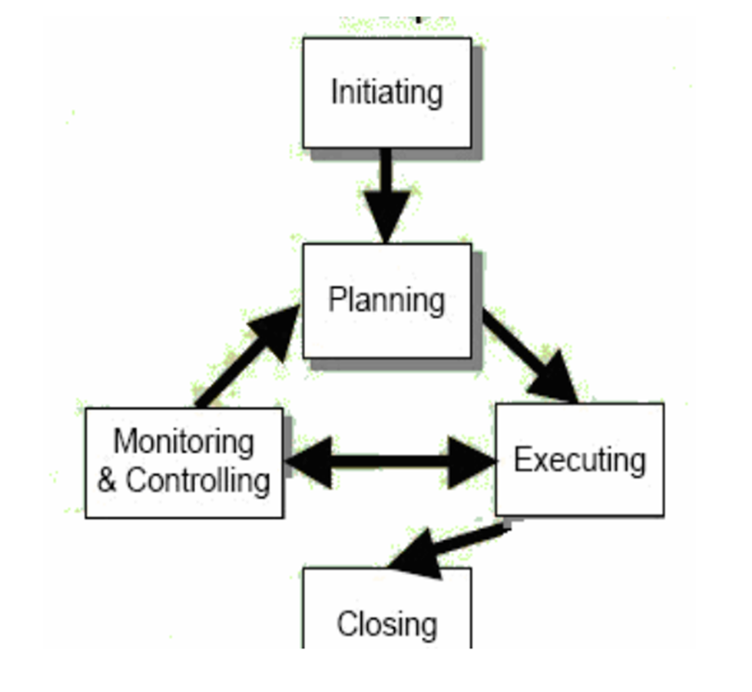
Software Project Planning
SPM Process
Project Initiation
Project Planning
Executing
Monitoring and Control
Closing
The overall goal of project planning is to establish a pragmatic strategy for initiating, scoping, controlling, tracking, and monitoring a complex technical project.
Why?
So the end result gets done on time, with quality!

Slide 4
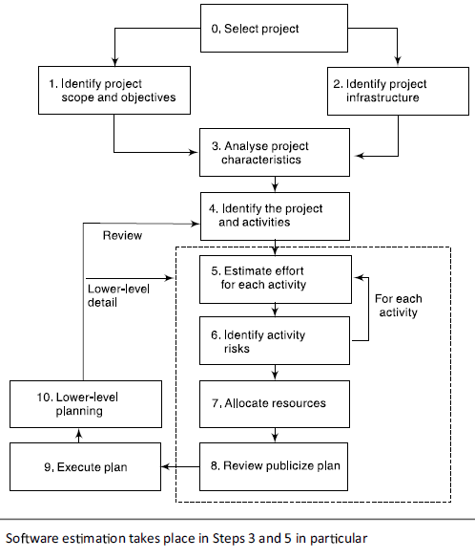
Project Planning

Slide 5
Project Planning Task
Establish project scope
Determine feasibility
Analyze risks
Define required resources
Determine require human resources
Define reusable software resources
Estimate cost and effort
Decompose the problem
Develop two or more estimates using size, function points, process tasks or use-cases
Reconcile the estimates

Slide 6
Project Planning Task (contd.)
Develop a project schedule
Establish a meaningful task set
Define a task network
Use scheduling tools to develop a timeline chart
Define schedule tracking mechanisms

Slide 7
Estimation
Estimation is about:
determining the project scope and its constraints
Elaboration (decomposition) is necessary
investigating the quality as required by the client
preparing the project schedule and budget
adjusting to the available resources
taking into consideration the uncertainty in the project and project risks
Historical metrics are very helpful
Is used to study and to predict the resources or time necessary to implement requirements

Slide 8
Estimation (contd.)
Estimation carries inherent risk and this risk leads to uncertainty
Is used to analyse the viability of the investment analysis, to come up with a realistic pricing and to bid for a project competitively
Estimation of resources, cost, and schedule for a software engineering effort requires
experience
access to good historical information (metrics)
the courage to commit to quantitative predictions when qualitative information is all that exists
Estimation techniques help project managers accurately estimate essential elements, such as cost and scope, resources within their projects
provide better forecasts to clients and more accurately budget the funds and resources they need for project success

Slide 9
Estimation (contd.)
Therefore proper project planning and control is not possible without a sound and reliable estimate
Estimating size and cost are one of the most important topics in the area of software project management

Slide 10
Software Estimates/ Software efforts estimate
Unlike other types of projects, software is an intangible product where specifications are not very obvious especially at its initial stages
This characteristic puts software in a delicate position where inconsistency and vagueness of the project attributes makes the work estimation more difficult
effort estimation is the process of predicting the most realistic amount of effort (expressed in terms of person-hours or money) required to develop or maintain software based on incomplete, uncertain and noisy input.
Effort estimates may be used as input to project plans, iteration plans, budgets, investment analyses, pricing processes and bidding rounds

Slide 11
Software Estimates/ Software efforts estimate (contd.)
In a project it is very important to know:
how long will it take
how much effort will be required
how many people will be involved
how many resources do I need
what are the risks
Availability: time a staff person is able/willing to work
Productivity: the relative measure of work in a time unit. People hours left in a day.

Slide 12
Software Estimates/ Software efforts estimate (contd.)
Level of effort: a type of support activity that is characterized by a consistent rate of activity over a given period of time rather than in terms of specific accomplishments
Staff effort: time required to complete tasks. Usually measured in increments such as person-hours
Working time: time available for work. Usually measured in working hours/day, working hours/week, working hours/month
Calendar time (elapsed time): time required to perform the effort, considering the working time. Usually measured in calendar days, calendar weeks or calendar months
Expenses: a charge incurred when a bill or invoice is processed or when work time is reported against the project’s authorized job codes

Slide 13
What to estimate?
Effort: the number of labor units required to complete an activity or other project element
Activity Duration: number of work periods required to complete an activity or other project element.
Continuous duration is work time that is not interrupted.
Interruptible duration is work time that might be interrupted.
Resources: any necessary item that might be directly used in & charged to the project
People
Equipment
Cost
Direct costs: labor, materials, equipment, services and fees that are charged to the project & must be traceable
Indirect costs: overhead & admin expenses. Overhead might include user training (course development, classroom costs, etc)

Slide 14
When to estimate?
Estimate is done many times throughout the project lifecycle
Prepare estimates:
After WBS is developed
When determining whether to bid on an opportunity
When taking over a project to validate proposal estimates
When moving to the next phase of a project
When an assumption proves to be invalid
When the WBS changes to ascertain the effort and cost associated with the changes
When there are authorized changes in resources, materials or services
Notes:
Continuous estimation shouldn’t differ enormously with the initial one.
Get a re-estimate when taking over someone else’s project.
Don’t do buffers. Do risk containment.
Re-estimate if there is any authorized changes.

Slide 15
How to estimate?
Software estimation is one of the most challenging and important activities in software development.
Software estimation can never be an exact science
Combination of good historical data and the use of a method can improve estimation accuracy
Make some assumption for estimation

Slide 16
Costing and Pricing
Estimates are made to discover the cost, to the developer, of producing a software system
There is not a simple relationship between the development cost and the price charged to the customer
Broader organisational, economic, political and business considerations influence the price charged

Slide 17
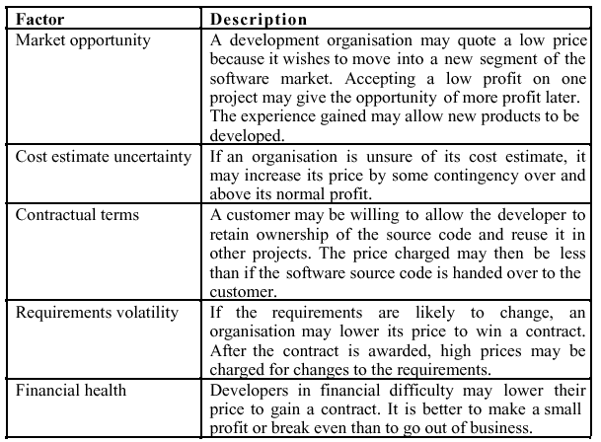
Software Pricing Factors

Slide 18
Estimation Types
A few elements are to be considered when choosing the right method to estimate software development:
team’s experience
the estimated lines of codes (LOC) to be delivered
the programming language used
the complexity of the software
the design methodologies
the environment for the tests to be conducted etc.

Slide 19
Estimation Types (contd.)
From the point of view of the input data, estimation methods can be divided into three groups:
data-intensive
expert-based
hybrid methods

Slide 20
Data-intensive method
The prediction relies upon an accurate estimation of:
the software size
its complexness
the number of interfaces needed or the number of screens
Made up of mathematics and statistics equations
Fixed and predefined
The input parameters have to be derived from various project properties in order to obtain a more precise estimation

Slide 21
Expert-based method
The characteristics include learning, inferring and analysing previous projects
Among the well known expert-based software models are the ones using soft computing methodologies like artificial neural networks (ANN), fuzzy logic (FL) and evolutionary computing (EC) which cater for real life situations where things are vague and flexibility is required to handle each one of them
Expert Judgement is the most commonly used technique but difficult to verify the accuracy of the results
Analogy Based Estimation (ABE) is a simple & flexible

Slide 22
Hybrid
Hybrid means combining the available data and expert knowledge in order to come up with a good estimate
The models are built by integrating expert opinion and data-driven techniques
Assumed to work better because there is no isolate technique that does not have any flaw nor one that can be accepted by everyone and hybridizing a few approaches is hoped to produce more realistic estimations

Slide 23
Planning Estimation
Establish the estimating objectives
Why are they being prepared?
What is the required accuracy?
Who is the intended audience?
When are the estimates needed?
Determine the project details
Identify required information to prepare estimates
Select the appropriate model
Develop the estimating strategy and plan
Identify estimators
Develop a plan to gather the estimates
Review history of similar projects

Slide 24
Key factors in Software Estimation
Project Manager has to balance between:
Cost
Schedule
Quality
Project costs involve:
Hardware costs
Travel and training costs
Effort costs
Notes:
Rough Order of Magnitude Estimate ("ROM") Estimated cost based on approximate cost models or expert analysis. It is usually based on top level requirements or specifications, and an overall prediction of work to be done to satisfy the requirements. The ROM is usually used for financial planning purposes only.

Slide 25
Software Cost Estimation
Software cost estimation is the process of predicting the amount of effort required to build a software system.
Cost estimates are needed throughout the software lifecycle.
Examining projects & characteristics helps develop underlying theory of how software development works & what factors generate highest costs.
Cost model gives us some idea of what project will cost.
Cost modeling is imprecise and difficult – it is important as a planning & evaluation tool.
Notes:
1.Algorithmic cost modeling -- model based on historical cost information – relates some software metric (eg. L.O.C.) to project cost; model predicts effort required
Halstead’s Software Science
Counted # operators & operands / module – gives project complexity
Counted # “mental discriminations” required to understand project to estimate effort required
COCOMO – Constructive Cost Model (Boehm)
Considered differences in types of projects
Modified values by 15 different factors including_
Programmer skill
Project attributes
Computer attributes
Product attributes
Albrecht’s Function Points – relies on functionality of software based on requirements (not code size)
Domain information; I/O, complexity

Slide 26
Software Cost Estimation (contd.)
Size is a primary cost factor in most models. There are two common ways to measure software size:
lines of code
function points
COCOMO Techniques (COnstructive COst Model Techniques)
Lines of Code: The most commonly used measure of source code program length is the number of lines of code (LOC)
Function points (FP): measure size in terms of the amount of functionality in a system.
COCOMO Techniques:
Considered differences in types of projects
Modified values by 15 different factors including_
Programmer skill
Project attributes
Computer attributes
Product attributes
Notes:
The abbreviation NCLOC is used to represent a non-commented source line of code. NCLOC is also sometimes referred to as effective lines of code (ELOC). NCLOC is therefore a measure of the uncommented length.
The commented length is also a valid measure, depending on whether or not line documentation is considered to be a part of programming effort. The abbreviation CLOC is used to represent a commented source line of code (Fenton, 1997).
Counts are made for the following categories (Fenton, 1997):
External inputs – those items provided by the user that describe distinct application-oriented data (such as file names and menu selections)
External outputs – those items provided to the user that generate distinct application-oriented data (such as reports and messages, rather than the individual components of these)
External inquiries – interactive inputs requiring a response
External files – machine-readable interfaces to other systems
Internal files – logical master files in the system

Slide 27
SLOC –source lines of code
a software metric used to measure the size of a computer program by counting the number of lines in the text of the program's source code.
SLOC is typically used to
Predict the amount of effort that will be required to develop a program,
Estimate programming productivity or maintainability once the software is produced.

Slide 28
SLOC –source lines of code (Contd.)
Very difficult to know how many LOC will be produced before they are written or even designed
LOC measure has become infamous
Still the most used metric
Average programmer productivity rate remains despite of new languages
Functionality and quality are the real concerns, not the LOC

Slide 29
Counting SLOC
To count the SLOC the following must be considered:
The count includes:
The SLOC delivered to client.
The SLOC written only by the development team are counted
The declaration statements are counted as source lines of code
The count excludes:
The code created by application generators.
The comments inserted to improve the readability of program.
Once, you get the numbers of line of code of SLOC, you can estimate or calculate the total effort and cost to complete the given project

Slide 30
SLOC example
/* Now how many lines of code is this? */
for (i = 0; i < 100; i++)
{
printf("hello");
}
In this example we have:
4 physical lines of code (LOC): is placing braces work to be estimated?
2 logical lines of code (LLOC): what about all the work writing non-statement lines?
1 comment line: tools must account for all code and comments regardless of comment placement.

Slide 31
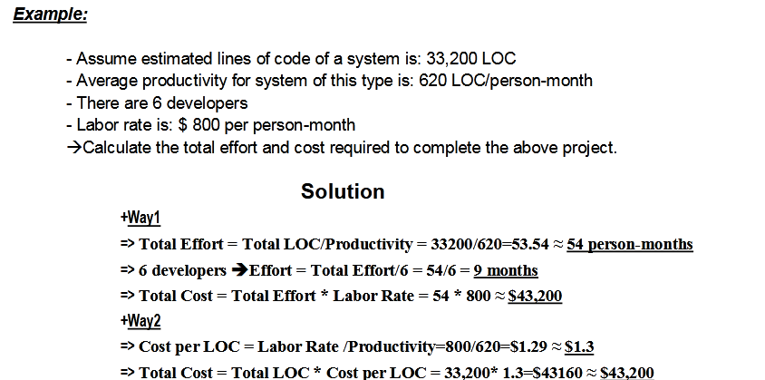
SLOC Numerical
Total Effort = Total Cost / Labor Rate = 43,200/800 = 54 person-months

Slide 32

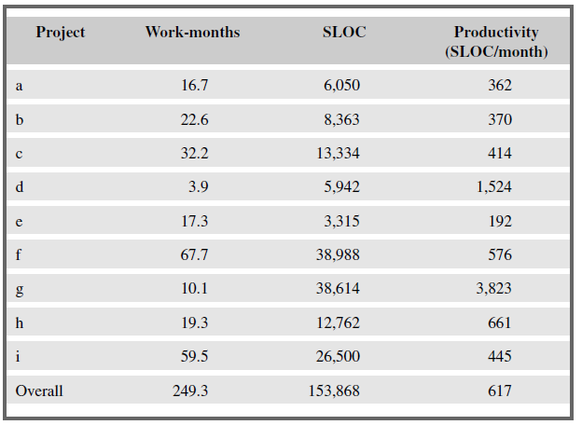
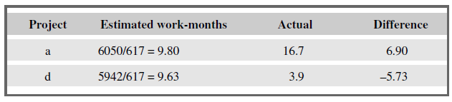
Estimated Effort → There would be an under-estimate of 6.9 work-months for project a and an over-estimate of 5.7 for project d

Slide 33
Advantages of SLOC
Widely used and accepted
Allows for comparison between diverse development groups
Directly relates to the end product
Easily measured upon project completion
Measure from the developer’s point of view
Continuous improvement

Slide 34
Disadvantages of Using SLOC Technique
The SLOC technique is language-dependent (i.e. It depends on specific type of language experienced).
The effort required to calculate source lines of code. This may not be the same for all languages.
Difficult to estimate early in the life cycle
Source instructions variate with language, design, programmer etc.
No industry standars for counting LOC
Fixed costs are not included with coding
Programmers may be rewarded for large LOC counts
Distinguish between generated code and hand-crafted code
Can not be used for normalizing if languages are different
Only existing products and expert opinions can be used to predict a LOC count

Slide 35
Function Points
Idea: software is better measured in terms of the number and complexity of the functions that it performs
Function points measure categories of end-user business functions
It is independent 'of the computer language, development methodology, technology, or capability of the project team developing the software project.
FPs are very subjective. They depend on the estimator.
Automatic function-point counting is impossible
Based on a combination of program characteristics
external inputs and outputs
user interactions
external interfaces
files used by the system

Slide 36
Function Point Process Steps
Count number of functions in each category (outputs, inputs, interfaces etc..)
Apply complexity weighting factors (simple, medium, complex)
Apply environmental factors
Calculate complexity adjustment factor
Compute adjusted function points
Computed by multiplying each raw count by the weight and summing all values
FP = CT * (0.65 + 0.01 * ΣFi)
CT= Count of number of functions in each category
Fi= Complexity factors

Slide 37
Function Point Process Steps
Convert to Lines of Code (optional)
FPs can be used to estimate LOC depending on the average number of LOC per FP for a given language
LOC = LOC per FP * FP
LOC = AVC * number of function points
Average number of LOC/ FP for a given language (AVC)
AVC is a language-dependent factor varying from 200-300 for assemble language to 2-40 for a 4GL
Notes:
4th Generation Language=4GL

Slide 38
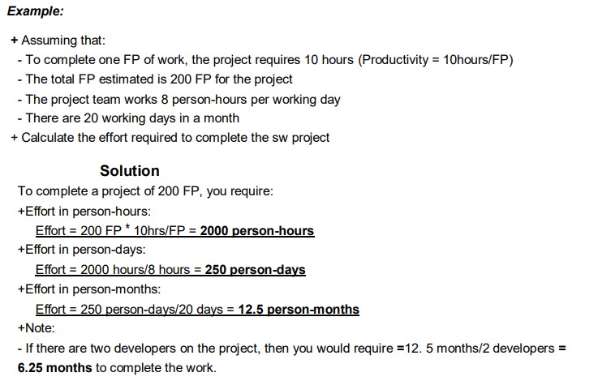
Function Point Example

Slide 39
Advantages of Function Point Analysis
Can be applied early in the life cycle
Independent of language and technology
Provide a reliable relationship to effort
Can be used as a productivity goal
Users understand better
Provide a mechanism to track and monitor scope
Environmental factors are considered

Slide 40
Disadvantages of Function Point Analysis
Requires subjective evaluations
Results depend on technology used to implement the analysis
Many effort and cost models depend on LOC, must be converted
Best after the creation of a design specification
Not good to non-MIS applications

Slide 41
Software Cost Estimation
Software project managers must estimate how much a software development is going to cost for the project budget.
Types of costs:
Facilities costs
Hardware & software costs
Costs for physical space for team
Project management costs
Standards
Training
Travel
Management methods
People costs
Salary
Notes:
Software cost estimation is the process of predicting the amount of effort required to build a software system.
Models provide one or more mathematical algorithms that compute cost as a function of a number of variables.
Size is a primary cost factor in most models and can be measuring using lines of codes or function points.
Models used to estimate cost can be categorized as either cost models or constraint models.
COCOMO is an example of a cost model and SLIM is an example of a constraint model.
Although criteria for evaluating model have been suggested, there are some fundamental problems with existing models.
Many models are available as automated tools.

Slide 42
Effort
Effort is the number of labor units required to complete an activity or other project element
The estimated range of effort required for a project, or parts of a project, can be determined using:
a calibrated estimation model based on historical size and effort data (when available)
other relevant methods such as expert judgment and analogy
Task dependencies can be established and potential opportunities for completing tasks concurrently and sequentially can be identified and documented using a Gantt chart, for example.

Slide 43
Software Effort Estimation
After sizing the product (functional size measurement), the effort to be expended shall be estimated in person months (or hours) using the size and additional estimation parameters
The estimated effort is distributed across the phases of the project as the basis for project planning and scheduling
For the total project plan, an estimate must also be made for the effort for project management and quality assurance
Often the project management and quality assurance efforts are overlooked or forgotten, and this leads to severe miscalculations and underestimating

Slide 44
Schedule
Determine the start and finish dates for project activities.
If the start and finish dates are not realistic, the project is unlikely to be finished as scheduled.
The schedule development process must often be iterated (along with the processes that provide inputs, especially duration estimating and cost estimating) prior to determination of the project schedule.

Slide 45
Software Schedule Estimation
Early and precise estimations are necessary and desirable by software clients
However, early estimations are usually imprecise and prone to a high degree of uncertainty
Estimates must be updated and revised whenever important influencing factors change
If changes are not considered and actualized, the plan made from the original estimation will never be met

Slide 46
Software Schedule Estimation
Suggestion for Milestones for IT project estimation
(Bundschuh & Dekkers, 2008)

Slide 47
Estimate is …
An assessment of the likely quantitative result
An approximate judgment of the effort, cost & time to perform a specified piece of work
A quotation for a piece of work that cannot be exceeded without notice given
A document containing resources & consumption:
What resources require?
Who will supply them?
When are they needed?
How long they are needed?
Notes:
PM’s reasons for estimating:
Evaluate a project’s probable costs before authorizing implementation
Have a basis for tracking & managing project expenditures using activity-based costing or other methods
Establish managerial baselines against which to measure expenditures
Evaluate routine project decisions with greater accuracy
Establish resources required & the resulting schedule
Provide fact-based info to support investment analysis
If project is not affordable, descope or choose cheaper resources.

Slide 48
Estimate is not …
Account strategy
Pricing
Investment marketing
Client satisfaction
Software or tools
Finding the fastest way

Slide 49
Problems with Over- and Under-Estimates
an over-estimate may cause the project to take longer than it would otherwise.
This can be explained by the application of two ‘laws’.
Parkinson’s Law
Brook’s Law

Slide 50
Parkinson’s Law
“Work expands to fill the time available”
i.e. given an easy target/task, staff will work less hard and will complete the project by the deadline even though the task can actually be completed in less time with maximum effort
Hence such working tendency leading to inefficient use of time and resources and affects project performance

Slide 51
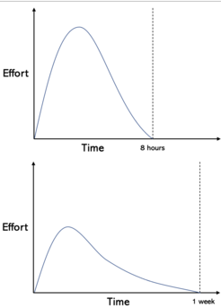
Figure : Parkinson's Law on the same amount of work
For instance, a person has one week to complete a task that takes 8 hours, but instead of completing it on the first day using all of their effort, the person will use less effort and spent a week.
According to Parkinson's Law, a person will spent all of the available time to complete a task regardless of the tasks size.
This tendency leads to inefficient use of time and resources and affects project performance.

Slide 52
Parkinson’s Law (contd.)
**!!! Project managers can use Parkinson's Law to understand how people work and to ensure productivity and efficiency.
An analogy to understand Parkinson’s law in Project management
An elderly lady spending a whole day writing and sending a postcard.
A busy man could do it in three minutes, yet the lady spends the day worrying and stressing over sending the postcard
Parkinson’s Law describes the tendency that people will spent all of the allocated time to complete a task regardless of the time it actually takes to complete it.
Likewise, a person will not complete a task before a deadline, resulting in inefficient use of resources and time.

Slide 53
Parkinson’s Law (contd.)
There are a number of reasons why people are not interested in completing work before its deadline.
Chen and Hall (2021) highlight
the desire to appear busy to not receive additional tasks,
the desire to avoid having resources withdrawn as a result of over-performance,
and the natural tendency towards laziness and procrastination.

Slide 54
Implication Of Parkinson’s law on PM
The behavior associated with Parkinson’s Law has a great influence on project performance. Along with student syndrome, it is one of the reasons why projects are routinely inefficient and delayed.
Within project scheduling, it is important project managers are aware of the behavior caused by Parkinson's Law and how they can minimize it with scheduling.
According to Parkinson's Law, a task is either completed on time or delayed. A task is not completed and delivered before its deadline.
To achieve the most efficient use of resources and time, the time allocated for each task in a project needs to correspond with the time to completion using maximum effort.
The accuracy and quality of the duration estimates depends on how detailed and precise available data is.
While doing your group project beware of it and estimate the effort for each task according to this law

Slide 55
Brook’s Law
“Adding manpower to a late software project makes it later”
When some project is on tight deadlines, then the project manager moves a couple of developers from another team/project to help deliver the project on time.
But after that, new developers need to learn about the project, business logic and it takes some time.
Naturally, new developers will ask questions about the current state of the project and code.
Guess who will answer and help those new developers?
current developers will need to do it, not the project manager
The effect on project estimation → If there is an overestimate of the effort required, this could lead to more staff being allocated than needed and managerial overheads being increased.

Slide 56
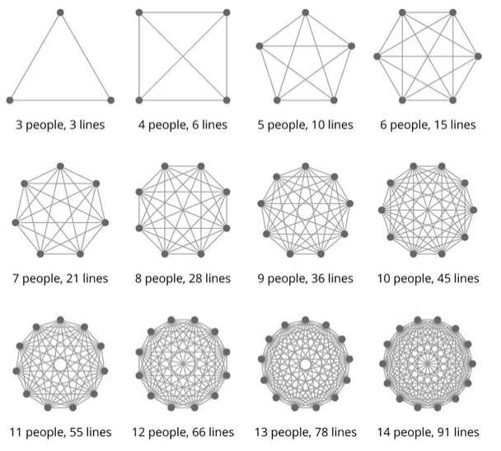
Brook’s Law (Contd.)
The effort of implementing a project will go up disproportionately with the number of staff assigned to the project.
As the project team grows in size, so will the effort that has to go into management, coordination and communication →relate with below figure

Slide 57
Problem with underestimation
The danger with the under-estimate is the effect on quality.
Staff, particularly those with less experience, could respond to pressing deadlines by producing work that is substandard.
This may be seen as a manifestation of Weinberg’s zeroth law of reliability: ‘if a system does not have to be reliable, it can meet any other objective’.
Substandard work might only become visible at the later, testing, phases of a project which are particularly difficult to control and where extensive rework can easily delay project completion.

Slide 58
Under estimation effect on project staff
Staff motivation and morale are enhanced where targets are achievable.
If, over time , staff become aware that the targets set are unattainable and that projects routinely miss targets, motivation is reduced.
People like to think of themselves as winners and there is a general tendency to put success down to our own efforts and blame failure on the organization.

Slide 59
Basis for SW estimation→ On what basis do you estimate efforts for a particular sw project??
Need For historical Data
Most estimating methods need information about past projects.
However, care is needed when applying past performance to new projects because of possible differences in factors such as programming languages and the experience of staff.
If past project data is lacking, externally maintained datasets of project performance data can be accessed. One well-known international database is that maintained by the International Software Benchmarking Standards Group (ISBSG), which currently contains data from 4800 projects.

Slide 60
Basis for SW estimation →2. Parameters to be estimated
Project managers need to estimate two project parameters for carrying out project planning.
1 effort
2 and duration
Duration is usually measured in months. Work-month (wm) is a popular unit for effort measurement.
Person-month (pm) is also frequently used to mean the same as work-month. One person-month is the effort an individual can typically put in a month.
The person-month estimate implicitly takes into account the productivity losses that normally occur due to time lost in holidays, weekly offs, coffee breaks, etc.
Person-month (pm) is considered to be an appropriate unit for measuring effort because developers are typically assigned to a project for a certain number of months.

Slide 61
Basis for SW estimation →3. Measure Of Work/Project Size
Work itself can be characterized by
A. cost in accomplishing the project
B. and the time over which it is to be completed.
So, First estimate the project size; and by using it, the effort and time taken to develop the software can be computed.
Project size is as an independent variable and the effort or time required to develop the software are dependent variables.
Direct calculation of cost or time is difficult at the early stages of planning due to:
The time taken to write the software may vary according to the competence or experience of the software developers might not even have been identified.
Implementation time may also vary depending on the extent to which CASE (Computer Aided Software Engineering) tools are used during development

Slide 62
Measure Of Work→ Project Size
The size of a project is obviously not the number of bytes that the source code occupies, neither is it the size of the executable code.
Project size gives an estimate of →How much complex the project in terms of the effort and time required to develop the product.
Two metrics are at present popularly being used to measure size.
1. Source Lines of Code (SLOC)
2. and Function Point (FP).

Slide 63
Software Effort Estimation Techniques
The main ways of deriving estimates of software development effort are:
1. algorithmic models, which use ‘effort drivers’ representing characteristics of the target system and the implementation environment to predict effort;
2. expert judgement, based on the advice of knowledgeable staff;
3. analogy, where a similar, completed, project is identified and its actual effort is used as the basis of the estimate;
4. Parkinson, where the staff effort available to do a project becomes the ‘estimate’;

Slide 64
Software Effort Estimation Techniques (Contd.)
5. Price to win, where the ‘estimate’ is a figure that seems sufficiently low to win a contract;
i.e. The software cost is estimated to be whatever the customer has available to spend on the project. The estimated effort depends on the customer's budget and not on the software functionality.
It identifies the correct balance of capability that can be delivered to the customer at the value the customer wants. Price-to-Win provides management insight for:
Competitive positioning
Strategic partnering
Risk tolerance
Customer relations
Optimal bid strategy

Slide 65
Software Effort Estimation Techniques (Contd.)
6. top-down, where an overall estimate for the whole project is broken down into the effort required for component tasks;
bottom-up, where component tasks are identified and sized and these individual estimates are aggregated.
parametric estimating, is a statistical relationship between historical data and other variables and accuracy-based technique for calculating the time, cost, and resources needed for project success
Two Types
Deterministic
Probabilistic
Notes:
Hybrid, can be applied to a total project or to segments, Need historical data

Slide 66
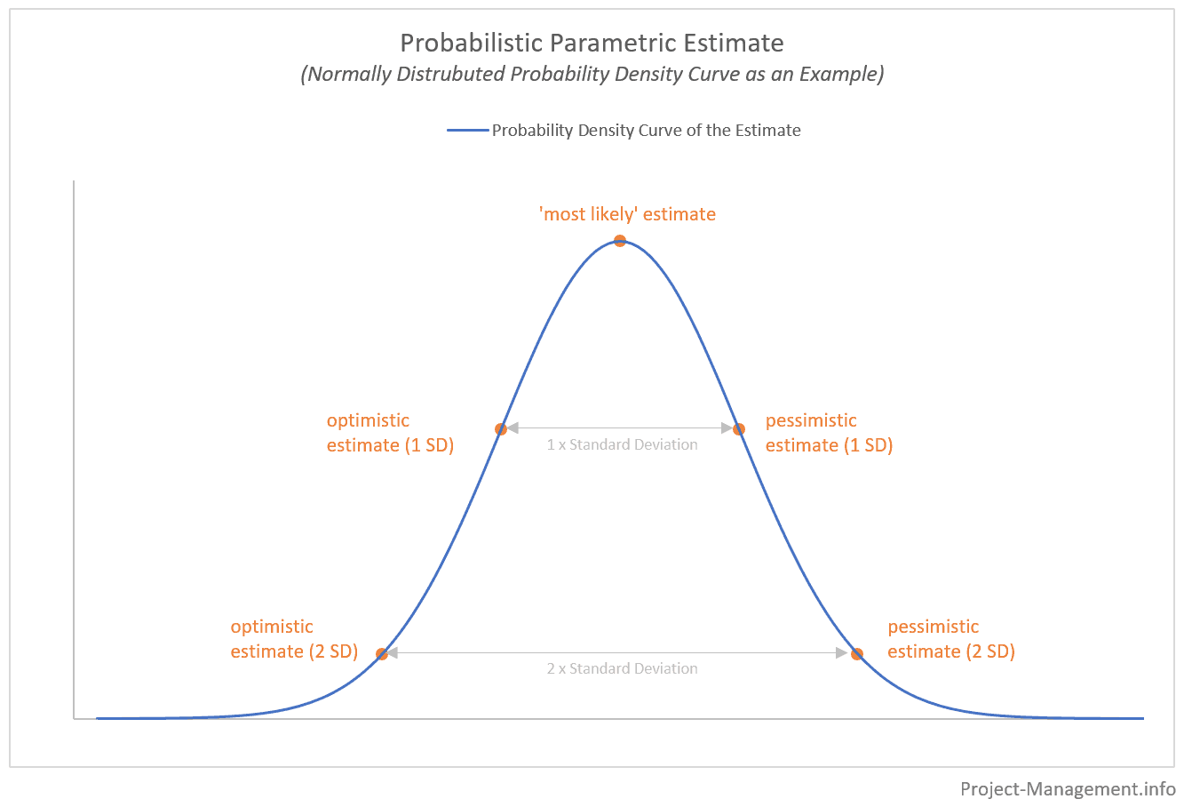
Parametric estimating

Slide 67
Task Top down vs bottom up –apply 5w1h/W5H
5W1H/W5H
Why?
What?
When?
Who?
Where?
How?
Note →the ‘Parkinson’ method is not really an effort prediction method, but a method of setting the scope of a project.
Similarly, ‘price to win’ is a way of identifying a price and not a prediction.

Slide 68
Bottom Up Estimate
“Start at the component level and estimate the effort required for each component. Add these efforts to reach a final estimate.”
In it the estimator breaks the project into its component tasks.
With a large project, the process of breaking it down into tasks is iterative: each task is decomposed into its component subtasks and these in turn could be further analyzed.
Process of breaking it down into tasks is suggested to be repeated until you get tasks an individual could do in a week or two.
The bottom-up part comes in adding up the calculated effort for each activity to get an overall estimate.

Slide 69
When to use Bottom up
the bottom-up approach starts the cost calculation process with the identification and evaluation of separate project components. SO, The expenditures for every individual project task or a series of tasks are then summed up to arrive at the total project cost.
best at the later, more detailed, stages of project planning.
If this method is used earlier, assumptions about the characteristics of the final system and project work methods will have to be made.
Due to above reasons Bottom up is used where a project is completely novel or there is no historical data available, the estimator would be forced to use the bottom-up approach.

Slide 70
ADV vs disadv
Pro: The bottom-up estimation technique can be very accurate in case a thorough and complete work breakdown structure is applied.
Con: The development of a work breakdown structure is usually time-consuming and requires much effort, especially if the project under consideration is a complex one.

Slide 71
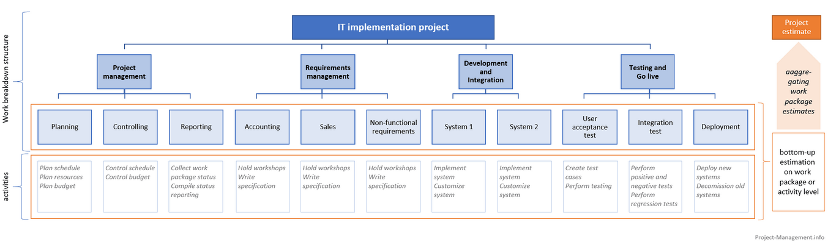
Bottom Up approach Example
A WBS Of an IT project

Slide 72
Bottom up example (contd.)
Once the WBS is defined and activities are specified , the work package owners are asked to estimate
1. the resource needs (headcount),
2. the duration
3. and the total costs for each activity under their work package.
The next slide figure shows the granular estimates for the activities, their aggregation to the work package level and the entire project.

Slide 73
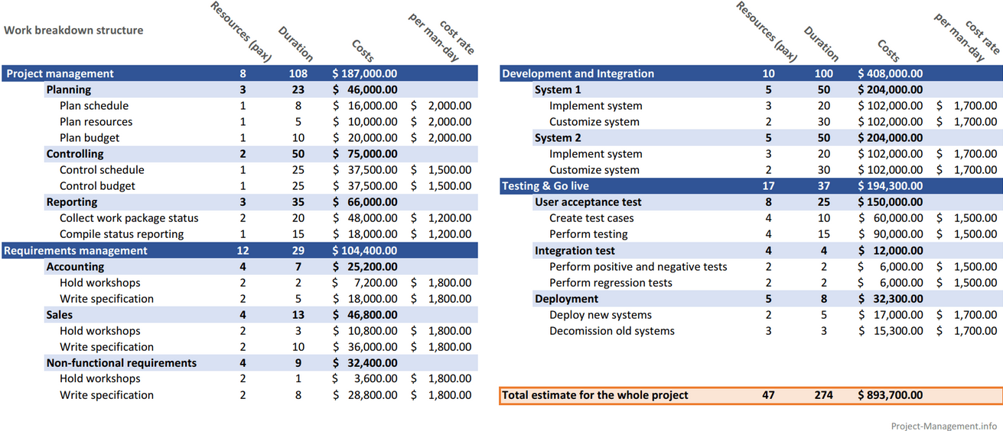
Fig → granular estimates for the activities, their aggregation to the work package level and the entire project

Slide 74
Problems with Estimating
Subjective nature of estimating and Problem is not well understood
people tend to underestimate the difficulty of small tasks and over-estimate that of large ones
Little or no historical data
No standards
Management uses estimates as performance goals
Political Implications
Developers are optimistic
Customer demands quick estimates etc.
If incomplete or incorrect estimate:
disappointing the customer
possibly losing future business
too optimistic fixed-price contract result in the contractor losing money and losing face

Slide 75
Summary on Estimation
Estimation contributes to making process improvements measurable
Estimate as much as possible
Estimation must be used cautiously
Implement several techniques
Most important: make use of historical data
Use reliable assumptions
Student Syndrome: Procrastination until the last minute
Manage Expectation
Notes:
1

Slide 76
Discussion #1
About software estimate:
"It takes too much time."
"They're not useful."
"They'll be wrong.“
“There are lot of assumptions.”
So, why do we still need to do estimate?
Notes:
Estimates Provide an Important Signal. Not estimating means the team will miss an important signal: the variation of the estimates.
When the estimates are far apart it signals that the team understands the problem differently. A developer with a low estimate may know of a library or a tool that can speed things up. A developer with a high estimate may know of a pitfall that others have forgotten. Sometimes a designer may add time for user testing or quality assurance for automated testing.
Estimation Allows for Failing Early. Making estimates provides a baseline. It's not possible to know a team is running in to unexpected complication without first establishing what is expected.
When those unexpected complications happen, and they will happen, the team can work together to figure out how to adjust. There are a lot of options: adjusting the scope of the features, expanding the budget to buy new tools or services, expanding the team, or expanding the timeline.

Slide 77

Discussion #2
If it takes 5 people 8 hours to build a wall, how many hours will it take for 10 people to build the same wall?

